Slide 1
Tables
Displaying your Data

Slide 2
Tables Used to Be Evil
Tables are meant for
tabular data, not for layout

Slide 3
Design
Make sure to sketch your layout before you code.
Decide on the number of rows and columns
Decide if any rows/columns will span multiple cells

Slide 4
The Tags
<table> – the container tag
<tr>…</tr> - the rows
<td>...</td> - the columns

Slide 5
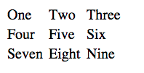
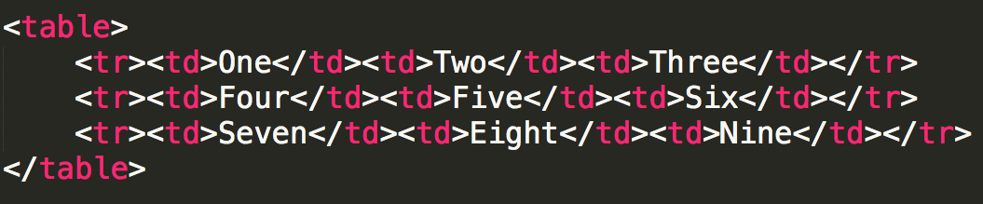
Simple Table

Slide 6
Table Headings
How would you add table headings? (The bold cells at the top that define the data.)
Some people use bold font, we use semantic tags
<th>..</th> -- table heading

Slide 7
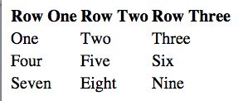
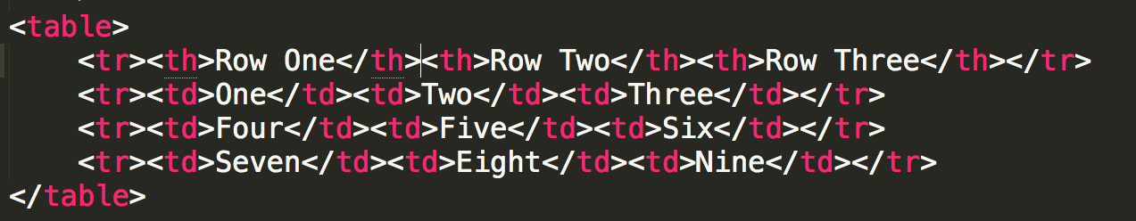
Table Headings

Slide 8
Spanning Multiple Cells
It may be the case that your table won’t be a perfect grid.
You can combine multiple rows and/or columns using the rowspan and colspan attributes.

Slide 9
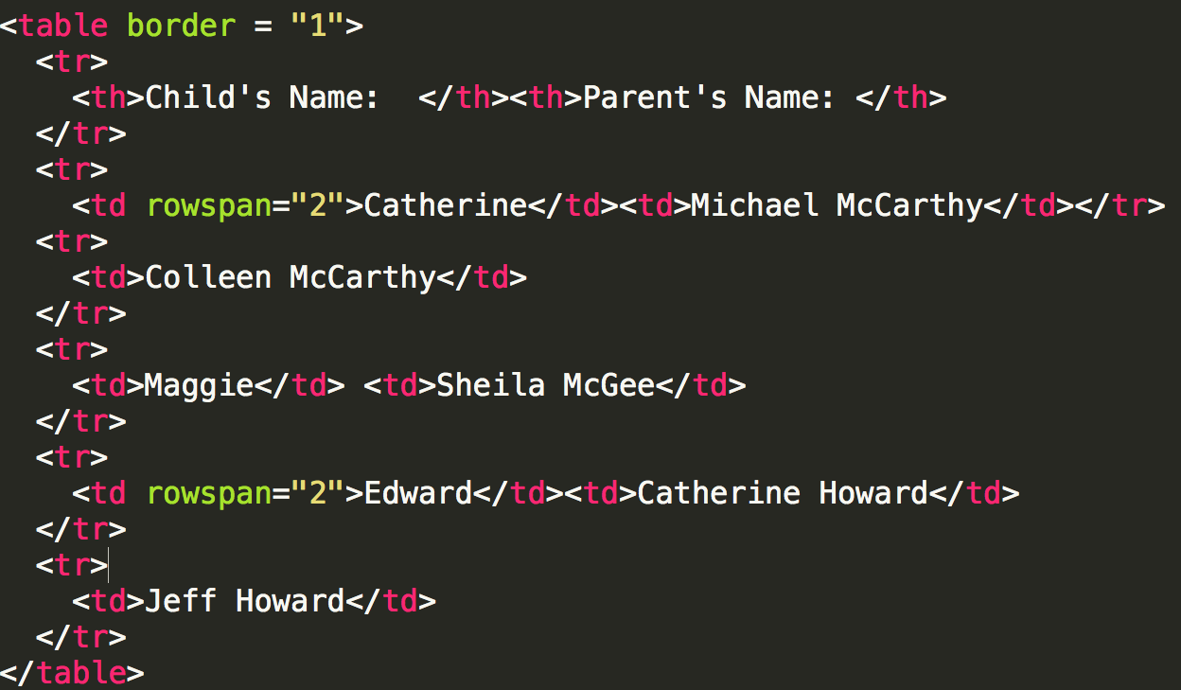

Slide 10
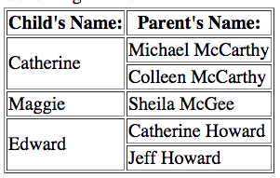

Slide 11
The Border Attribute
There are a number of attributes that tables can take, but in your HTML you should avoid styling.

Slide 12
Captions
How do you link text to the table? A heading (h2, h3, etc.) will look good, but doesn’t provide semantics.
Use <caption>

Slide 13
Review
Tables should only be used for tabular data
Draw your table before you code your table
Check for unclosed tags

Slide 14

Acknowledgements/Contributions
These slides are Copyright 2015- Colleen van Lent as part of http://www.intro-webdesign.com/ and made available under a Creative Commons Attribution Non-Commercial 4.0 License. Please maintain this last slide in all copies of the document to comply with the attribution requirements of the license. If you make a change, feel free to add your name and organization to the list of contributors on this page as you republish the materials.
Initial Development: Colleen van Lent , University of Michigan School of Information

